Slide 1
Diseases Of The Heart: Vanity
By: Hasan Suleiman

Slide 2
What Is Vanity
Definition: Excessive pride in your own accomplishments or thinking(but not saying)that your better than others.
Has a similar definition as arrogance

Slide 3
Examples of Vanity
A common example is someone who doesn't say anything to you but has a condescending attitude or acts like he/she is better than others.
Another example is if someone has a nice car he/she purposely drive that car in front of you every day just to say that they have a nicer car than you.

Slide 4
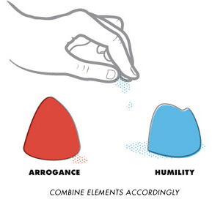
How To Tell If You Have Vanity
Vanity is very hard to detect
Have very good friends who will tell you’re being a jerk.
You have to constantly think about your actions
Think before you do or say anything that might bother others.

Slide 5
The Cure For Vanity
Vanity can be cured by always humbling yourself
Even if you have a shred of vanity in your heart put yourself below others
Not to an extreme point
Go out of your way to do things for people

Slide 7
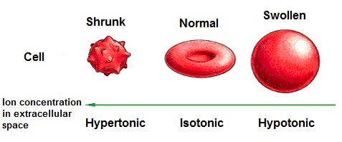
Tonicity
This type of heart is hypotonic
The person who has this disease is so full of themselves it explodes back on them.

Slide 8
Hadith/Ayah
And when they hear vanity they withdraw from it and say: Unto us our works and unto you your works. Peace be unto you! We desire not the ignorant-28:55
Surat al-Qasas

