Slide 1
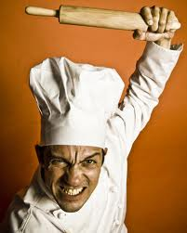
Anger
Waleed Huwio

Slide 2
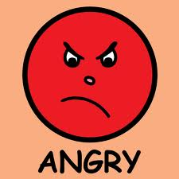
Hadieth About Anger
Hadith - Sahih Al-Bukhari 8.135, Narrated Abu Huraira, r.a.
Allah's Apostle said, "The strong is not the one who overcomes the people by his strength, but the strong is the one who controls himself while in anger.“
Hadith - Sahih Al-Bukhari 8.137, Narrated Abu Huraira, r.a.
A man said to the Prophet , "Advise me!" The Prophet said, "Do not become angry and furious." The man asked (the same) again and again, and the Prophet said in each case, "Do not become angry and furious."

Slide 3
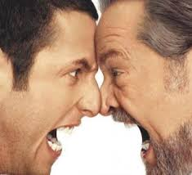
What the Quran Stated About Anger
The Noble Qur'an - Fussilat 41:34
The good deed and the evil deed cannot be equal. Repel (the evil) with one which is better (i.e. Allâh ordered the faithful believers to be patient at the time of anger, and to excuse those who treat them badly), then verily! he, between whom and you there was enmity, (will become) as though he was a close friend.

Slide 4
How to Control your Anger
The prophet once clearly stated if you get angry and you are standing sit down. If you are still angry lay down. And if you are still upset make wudh pray. After all that and you are still angry sleep it off.
This shows that it is very important to never stay angry and also never lose control of yourself when your angry.

Slide 5
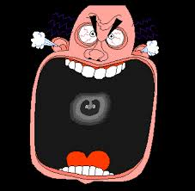
The Effects of Anger
If you are angry you may sometimes lose control of yourself and end up effecting people in a negative way.
When you angry you may end up doing something you regret.
You can lose your conciseness and end up hurting yourself or others.

Slide 6
Bibliography
http://muttaqun.com/anger.html
http://en.wikipedia.org/wiki/Anger
http://www.thefreedictionary.com/anger

