Slide 1
A Deadly Disease
By: Ibrahim Haydar

Slide 2
This disease is the quality of being unaware, lazy, unknowing, and uncaring
People with this quality tend to have their lives fly past them and end up regretting their decisions
These people “live in the moment”

Slide 3
In our day to day lives we often do not care about what is going on
We become lazy with our school work and fall behind on our assignments
We become unaware and uncaring about what is going to happen in the future

Slide 4
It is not for any person to believe, except by the Leave of Allah, and He will put the wrath on those who are heedless. (Chapter #10, Verse #100)
Draws near for mankind their reckoning, while they turn away in heedlessness. (Chapter #21, Verse #1)
Who are under a cover of heedlessness (think not about the gravity of the Hereafter (Chapter #51, Verse #11)
They are those upon whose hearts, hearing (ears) and sight (eyes) Allah has set a seal. And they are the heedless! (Chapter #16, Verse #108)

Slide 5
These ayat basically show that people use heedlessness as a cover, or a seal
They try to deny the Day of Judgment and its weight
Allah says they cannot hide from his wrath under the cover of heedlessness

Slide 6
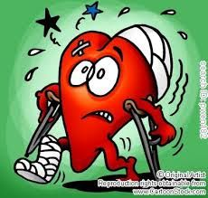
The tonicity this disease should go under is hypertonic
This is because the heart is not affected directly but this disease leads to many MUCH worse diseases
There is always time to wake up and become isotonic

Slide 7
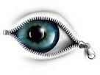
To cure this disease one must simply open their eyes
Then they come slowly out of laziness and unawareness
It is a process but opening your eyes will make you aware and cautious of other diseases

Slide 8
http://cooltext.com/Logo-Design-Pimpin
http://mstasnim.weebly.com/pure-isotonic-heart-project.html
http://www.scribd.com/doc/99907716/Purification-of-the-Heart-by-Hamza-Yusuf-Complete

