Slide 1
False Hope
By: Ibrahim Houissa

Slide 2
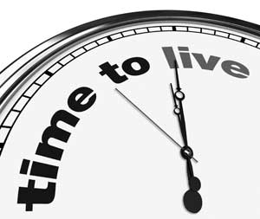
What is it?
False hope is believing that one has a long life ahead of him and won’t die soon.

Slide 3
Parts of False Hope
Wretchedness- Hard Hearted and Plunging Headlong
Felicitous- Fortunate and Cautious

Slide 4
Connection to Heart Types
This is one of the diseases that is of the Hypotonic Heart.
It is Curable.
It makes the Heart Weak.

Slide 5
Quran
It may be that those who disbelieve wish ardently that they were Muslims. (2) Let them eat and enjoy life, and let (false) hope beguile them. They will come to know! (3)

Slide 6
Hadith
The Prophet () drew up a square and in the middle of it he drew a line, the end of which jutted out beyond the square. Further across the middle line, he drew a number of smaller lines. Then he () said, "The figure represents man and the encircling square is the death which is encompassing him. The middle line represents his desires and the smaller lines are vicissitudes of life. If one of those misses him, another distresses him, and if that one misses him, he falls victim to another."

Slide 7
Dangers
It could be a form of shirk.
One does bad thinking he will have time to repent tomorrow.

Slide 8
Prevention and Cure
It can be prevented by living every day to its fullest and doing the best of deeds every day.
Also one must know that they will die and they have to accept that that is unknown and only controlled by Allah.
It can be cured by realizing your lack of power within your own life.

Slide 9
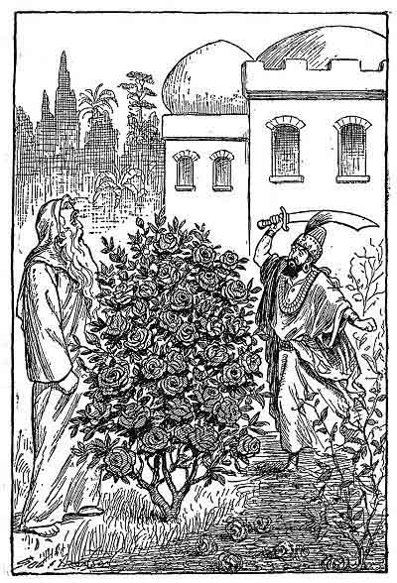
Story of Man and Shah
Reminder- Exception is one who hopes he will live long to finish something of benefit.
Hope for Benefit

Slide 10
Works Cited
http://sunnah.com/riyadussaliheen/1/577
http://www.scribd.com/doc/99907716/Purification-of-the-Heart-by-Hamza-Yusuf-Complete
http://quran.com/15

