Slide 1
Love Of The World
By: Noor Kobaia

Slide 2
What Is “Love Of The World?”
Loving something in the world and never wanting to let go of it
Examples:
Book
Video Game
Person
Food/Drink
Song

Slide 3
What Tonicity Does This Disease Fall Under?
ALL THREE!
Hypertonic
Hypotonic
Isotonic

Slide 4
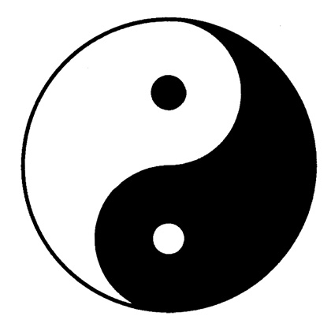
Isotonic: Balanced Heart
You should always love something in this world that grants you felicity in the hereafter. However, you will always make mistakes and love something inappropriate. There should always be a balance of good and evil but never more evil than good.
Good Things To Love:
The Quran
The Ka’ba
The Prophet (SAW)
YOUR PARENTS!
Books of knowledge
Children
Brothers and Sisters
Love of money so you can give your zakaat
Hadith: Do not curse the world, for God created the world, and the world is a means to reaching [knowledge of] God”
Quran: And He has subjected to you whatever is in the heavens and whatever is on the earth - all from Him. Indeed in that are signs for a people who give thought.

Slide 5
Hypertonic: Sick Heart
Everyone makes bad choices in their life and try to repent for Allah is the ever-merciful. Sometimes you sin more than you do good. Love of the world is something everyone has and it overcomes their Islamic being.

Slide 6
Hypotonic: Dead Heart
Love of the world overcomes Muslims all over the world and it breaks their iman. People are always falling into this disease because shatain plays with their minds.
Bad Thing To Love:
Celebrities
Greed
Too Much Praise
Something that is not being loved for the sake of Allah

Slide 7
Videos
https://www.youtube.com/watch?v=jMQGXjSo6Ac
http://www.youtube.com/watch?v=q5T4LBWdle4

Slide 8
Cure and Prevention
Prevention:
Always remember that Allah is watching you and that loving something in this world is going to get you nowhere. Keep your conscience intact so you can know when what you’re doing is going too far.
Cure:
Remember death in abundance and do not involve yourself in distant and remote hopes. The pursuit of distant schemes and material enterprises should be shunned. In this way the love of the world will be eliminated from the heart.

Slide 9
Thanks For Watching!
Always Remember: “The world is a bridge; so pass over it to the next world, but do not try to build on it.”

