Slide 1
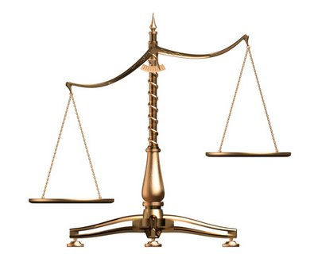
Iniquity
By: Naseem Heydari

Slide 2
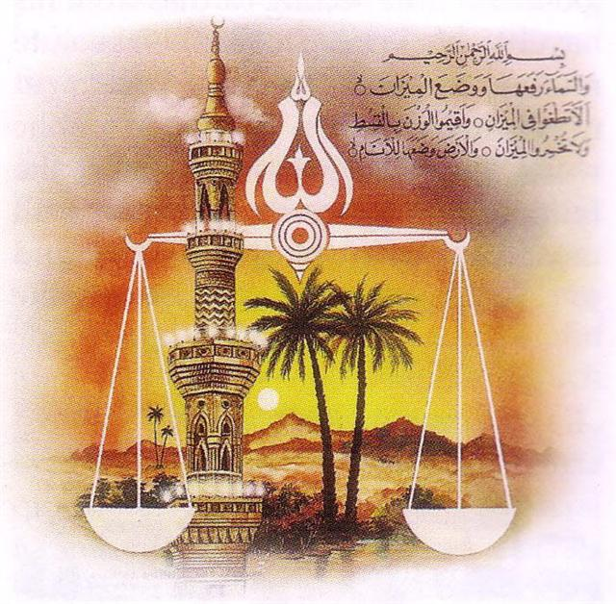
Video: Iniquity and Injustice In Islam
http://www.youtube.com/watch?v=bFyNVrTAcA4

Slide 3
What is Iniquity?
Being unjust or unfair
Lack of fairness or justice
Failing to give equal treatment; inequality
Harming any creation without a cause

Slide 4
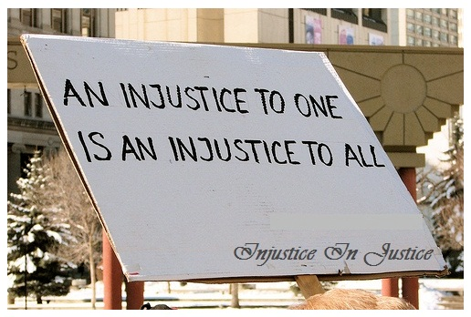
3 Types of Iniquity
Being unjust to Allah the Almighty
ex. disbelief, polytheism, hypocrisy
Being unjust towards other people
ex. unequal treatment, harm to others
Being unjust towards oneself
ex. hurting oneself weather it is physically or mentally

Slide 5
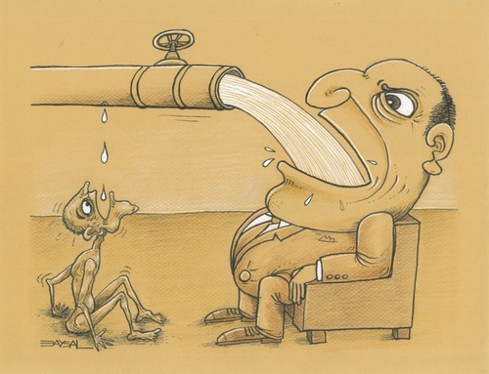
Examples of Iniquity
Favoring
Racism, discrimination
Giving one more than the other
Special Treatment: Not treating everyone with the same amount of respect
Harming any animals, humans, and plants (all creations of Allah)

Slide 6
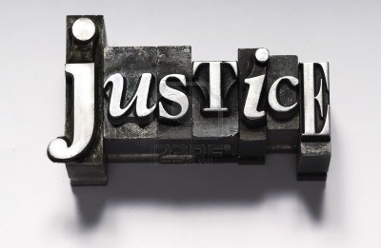
Evidence: Ayah
“Our Lord! Rescue us from this town whose people are oppressors; and raise for us from You one who will protect, and raise for us from You one who will help.” [004:075: Al Quran]

Slide 7
Evidence: Explanation
Oppressors could be leaders, husbands, or king
Oppressors will be punished
Oppressed will be rewarded

Slide 8
Cure and Prevention
Keeping in mind death is near; can come any moment
The Prophet said: “Remembering often the destroyer of pleasure.” That is death.
Remembering death cleanses the heart
Remembering that we will eventually stand in front of Allah in the Day of Judgment

Slide 9
Relation to Hypertonic Heart and Semi-Permeable membrane
Hypertonic heart is half good, half-bad
The heart knows what is wrong but is unable to be fair and act upon it
Iniquity (injustice) is bad trait and disease it has
There is still hope for the heart
Semi-permeable membrane only allows certain things in
The membrane is self-control so you choose what to let in
In hypertonic heart injustice is let in because it is the sick heart

Slide 10
Relation to Hypotonic heart
Injustice relates to a hypotonic heart when one has been unjust for so long they do not even realize it.
This is the worst state.

Slide 11
Relation to Isotonic Heart
Injustice relates to an isotonic heart when a person realizes Allah is watching them always and chooses not to be unjust or speak out against injustice when they see it.
This is a good state in which one has a high eman, but no one is perfect.

Slide 12
Bibliography
"Justice in Islam." The Religion of Islam. 30 Apr. 2013 <http://www.islamreligion.com/articles/376/>.
(nmusba.wordpress.com), AhleSunnah. "Purification of the Heart by Hamza Yusuf (Complete)." Scribd. 30 Apr. 2013 <http://www.scribd.com/doc/99907716/Purification-of-the-Heart-by-Hamza-Yusuf-Complete>.
. "Multimedia." Islam web. 30 Apr. 2013 <http://www.islamweb.net/emainpage/index.php?id=158709>.
"Justice of Islam Powerful Speech by Sh. Shady Al-Suleiman The Daily Reminder." YouTube. 31 Dec. 2012. YouTube. 30 Apr. 2013 <http://www.youtube.com/watch?v=bFyNVrTAcA4>.

