Slide 1
Obliviousness
To Blessings
By Derya Turk

Slide 2
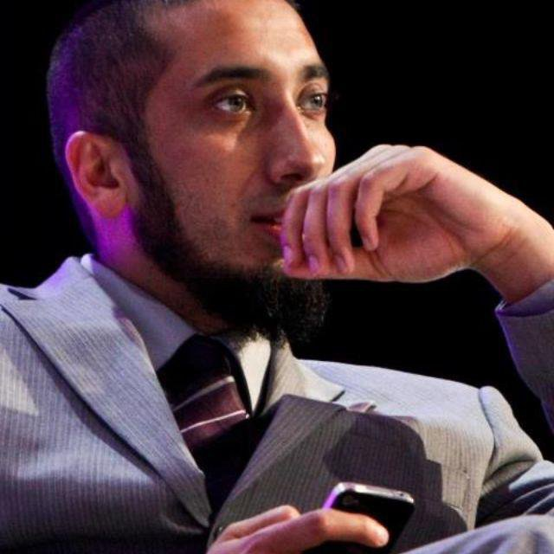
Gift From Allah
Nouman Ali Khan
http://www.youtube.com/watch?v=TSpbGHTqFec

Slide 3
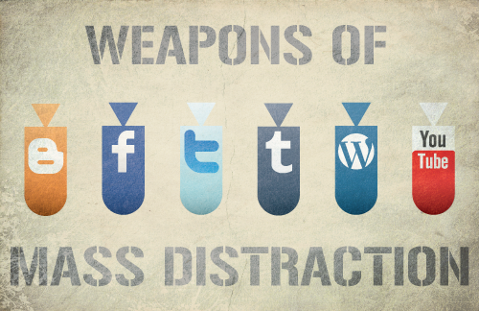
Ungrateful
Not feeling or exhibiting gratitude, thanks, or appreciation to the blessings Allah (SWT) has blessed you with.
Not expressing thanks and appreciation to those who do a favor for us.
Not knowing and recognizing that whatever we have is from Allah.
Focusing on Allah has become difficult today because of life’s distractions and attractions.
Not recognizing Allah’s blessings can prevent us from gaining His pleasure.

Slide 4
Women Being Ungrateful
Narrated Ibn 'Abbas: The Prophet said: "I was shown the Hell-fire and that the majority of its dwellers were women who were ungrateful." It was asked, "Do they disbelieve in Allah?" (or are they ungrateful to Allah?) He replied, "They are ungrateful to their husbands and are ungrateful for the favors and the good (charitable deeds) done to them. If you have always been good (benevolent) to one of them and then she sees something in you (not of her liking), she will say, 'I have never received any good from you." Sahih Bukhari, Volume 1, Book 2, Number 28

Slide 5
Hadith and Ayah
No one can come close to Allah, the one who gave us everything, As the Quran states: “Who created you, fashioned you perfectly, and gave you due proportion”[Infitar 82:7].
Allah says in the Quran: "And whatever of blessings and good things you have, it is from Allah” [al-Nahl 16:53]. He also says, “And He found you poor and made you rich [al-Duha 93:8].
Allah provides us a way to escape that punishment by being thankful to Him. He says, “Why should Allah punish you if you have thanked (Him) and have believed in Him. And Allah is Ever All-Appreciative (of good), All-Knowing” [(An-Nisa, Verse #147)].

Slide 6
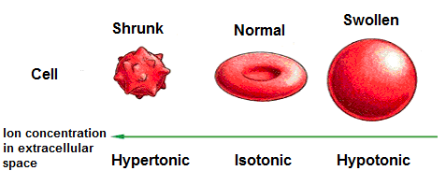
Tonicity and
Semi Permeable Membrane
Hypertonic: A sick heart, there are cures from being ungrateful, either you will be cured or stay on the wrong path. There are many cures.
Semi Permeable Membrane: Ungratefulness can be a barrier and stop you from praying and worshiping Allah. Stop you from doing good and start thinking negatively.

Slide 7
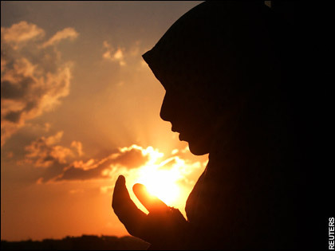
Cures and Prevention
of Disease
Constantly praying, making dua’a, and thanking Allah for what you have, can prevent you from being ungrateful.
Noticing what Allah has given you and being pleased with what you have.
Not comparing yourself to others.
Everything you have is from Allah and He can take it away at any minute.
Allah has blessed everyone with something, looks, wealth, knowledge, etc.
Don’t love this world, make the treasures of the hereafter your goal.

Slide 8
Bibliography
http://www.iqrasense.com/muslim-character/the-blessings-of-gratitude-and-shukr.html
http://www.islamweb.net/emainpage/index.php?page=articles&id=145008
http://xeniagreekmuslimah.wordpress.com/2010/11/06/are-you-being-ungrateful-or-you-are-pleased-with-allahs-decree/
http://www.iqrasense.com/muslim-character/the-blessings-of-gratitude-and-shukr.html

